Slide 1
Cards and Actions using Outlook Actionable Messages
Processing actions from actionable messages

Slide 2

Processing actions from actionable messages
Adding actions to cards
Registering in the Actionable Email Developer Dashboard
Registration criteria
Adding the Connect to Office 365 button to an existing web site
Validating the bearer token
Reporting success or failure
Refresh cards

Slide 3

Action processing overview
Office 365
Receive email with card
1
3
HTTP POST + bearer token
2
Submit
Status + refresh card
4
Outlook
Web app
Notes:
Action processing requires a publicly reachable endpoint that is pre-registered using the Actionable Email Developer Dashboard. You cannot use http://localhost as a URL because that is unreachable from Office 365.
User receives an email with an actionable message embedded in the <script> tag
User interacts with the message action defined in the card such as HttpPOST
The HTTP POST message is sent from Office 365 to the pre-registered endpoint. The HTTP POST includes a bearer token that should be validated.
The status is returned in the HTTP header CARD-ACTION-STATUS with a value indicating success or failure. Optionally, the response body can contain JSON to represent the new UI of the card after successful processing. This requires the CARD-UPDATE-IN-BODY HTTP header with a value of “true”

Slide 4
Actionable messages via email
Card-enabled mail client
Email Server
https://api.contoso.com
Office 365
Send email w/ card
Retrieve email w/ card
Invoke httpPOST action
httpPOST + bearer token
Status + refresh card
Card response
Notes:
The process begins by your web application sending an Actionable Message to your email server. This can be Office 365 or can be another email server that meets requirements (see https://docs.microsoft.com/en-us/outlook/actionable-messages/security-requirements).
A client capable of displaying message cards displays the email. Clients not capable of displaying message cards will only show the message body, so it’s important to include a meaningful message body.
The card-enabled client, such as Microsoft Outlook, enables the user to click on an action such as “Approve Expense Report”. This causes a message to be sent to Office 365.
Office 365 then sends an HTTP POST request to your application, adding an HTTP header “Authorization: bearer “ plus a signed Oauth token (JWT formatted token).
Your application validates the token, then sends as the response an HTTP header indicating success or failure. Additionally, the body of the response can include JSON data representing the new UI for the card.
Finally, the full response is sent back to the mail-enabled client from Office 365.

Slide 5
Adding actions to cards
Action | Description
OpenUri | Opens a URI in a browser or app "targets": [ { "os": "default", "uri": "https://yammer.com/.../123" }, { "os": "iOS", "uri": "yammer://u/123" }, { "os": "android", "uri": "yammer://u/123" }, { "os": "windows", "uri": "yammer://u/123" } ]
HttpPOST | HTTP POST request is sent to the specified URL, containing an HTTP authorization bearer token header and optional limited purpose token
ActionCard | Presents additional UI that contains one or more Inputs, along with associated actions that can be either OpenUri or HttpPOST types.
Notes:
Although links can be achieved through Markdown, an OpenUri action has the advantage of allowing you to specify different URIs for different operating systems, which makes it possible to open the link in an app on mobile devices.
When an HttpPOST action is executed, a POST request is made to the URL in the target field, and the target service needs to authenticate the caller. This can be done in a variety of ways, including via a Limited Purpose Token embedded in the target URL. For more information and help on choosing the security mechanism that works best for your particular scenario, please see Security requirements for actionable messages.

Slide 6
HttpPOST action
"potentialAction":[{
"@type": "ActionCard",
"name": "Approve",
"inputs": [{
"@type": "TextInput",
"id": "comment",
"isMultiline": true,
"title": "Reason (optional)" }],
"actions": [{
"@type": "HttpPOST",
"name": "Submit",
"target": "https://api.contoso.com/expense?id=9876&action=approve",
"body": "={{comment.value}}",
"headers": [{ "Content-Type": "application/x-www-form-urlencoded" }]}]
},
Notes:
httpPOST action in a card, either as the potentialAction or as an action within an ActionCard element, provides properties that you can control the data being sent to your web API. Here we see the URL that is being POST’ed to, the HTTP body, and an HTTP header indicating the content type of the data being processed.
The handlebars syntax allows binding to other elements, here we bind to the value of the “comment” input. Note the equals sign preceding the value in the body. This is because our WebAPI sample uses a primitive type instead of a complex type for ease of demonstration. Consider creating a complex type and creating a view model to process it.
For information on posting FORM data to Web API, see:
https://docs.microsoft.com/en-us/aspnet/web-api/overview/advanced/sending-html-form-data-part-1

Slide 7

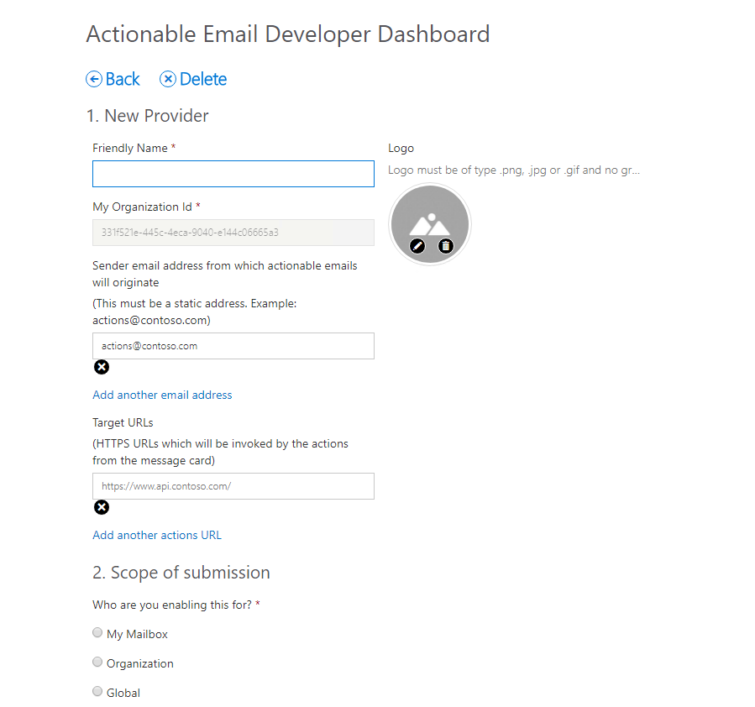
Actionable Email Developer Dashboard
https://outlook.office.com/connectors/oam/publish
Notes:
Your Action URLs will not work until the URL is registered in the Actionable Email Developer Dashboard.
Developer flow:
Use the MessageCard Playground to view samples and design your own cards.
Use the Actionable Email Developer Dashboard to register providers (whitelist URLs)
Test your provider’s actions
Every unique scope (My Mailbox, Organization, or Global) must be registered individually.
Developers aren’t blocked on the approval, they can send actionable messages to themselves – cards would render and actions would work without requiring an approval. The approval is required only to be able to send actionable messages to others.

Slide 8

Registration criteria for global submission scope
Emails must be authenticated via DKIM or SPF
Top-level domain (TLD) of the SPF check or DKIM signature must match the TLD of your From: email address
Emails must come from a static email address
Emails must follow the email sender guidelines
Consistent history of sending a high volume of mail from your domain
Very low rate of spam complaints from users
Use high-fidelity, routine and simple actions available for your service, otherwise use OpenUri actions for complex interactions
Actions should be used for transactional email where a high interaction rate is expected, they should not be used for promotional bulk mail
https://docs.microsoft.com/outlook/actionable-messages/actionable-email-dev-dashboard
Notes:
This section is only applicable when your scope of submission to enable actionable messages is Global.
In this section, you need to provide details for Microsoft to verify the actionable message and the corresponding actions that are invoked from the email sent by your provider/service.
Additionally, send a valid email coming from your production servers (or a server with similar DKIM/SPF/From:/Return-Path: headers) including the markup to amverify@microsoft.com. This procedure will enable Microsoft to determine that the solution complies with all the guidelines and requirements listed in Registration Criteria.
Make sure that the markup is correct prior to sending the email.
Office 365 removes all markup when forwarding an email. Do not forward the email but send it directly.

Slide 9
Validating the bearer token
Validation library:
NuGet Package: Microsoft.O365.ActionableMessages.Utilities
Validation class: Microsoft.O365.ActionableMessages.Authentication.ActionableMessageTokenValidator
Source: https://github.com/OfficeDev/o365-actionable-messages-utilities-for-dotnet
Verifies the following:
The token is issued by Microsoft and its digital signature is valid.
The token has not expired.
The audience claim matches the service domain URL.
var validator = new ActionableMessageTokenValidator();
var result = await
validator.ValidateTokenAsync(
Request.Headers.Authorization.Parameter,
"https://api.contoso.com");
Notes:
Office 365 will call your configured URL, passing an Authentication header with a value of “bearer” plus a signed, encoded token. Your web API can inspect the bearer token and use the Microsoft.O365.ActionableMessages.Utilities NuGet package
ValidateTokenAsync will verify the following
1. The token is issued by Microsoft and its digital signature is valid.
2. The token has not expired.
3. The audience claim matches the service domain URL.
The source code for the library is available at:
https://github.com/OfficeDev/o365-actionable-messages-utilities-for-dotnet

Slide 10
Validating the bearer token
public async Task<HttpResponseMessage> Post([FromBody]string value)
{
//Validate token
var validator = new ActionableMessageTokenValidator();
var result = await validator.ValidateTokenAsync(Request.Headers.Authorization.Parameter, "https://api.contoso.com");
if (!result.ValidationSucceeded) {
return CreateCardResponse(HttpStatusCode.Unauthorized, "Invalid token");
}
//Custom business logic to validate the sender and/or performer
if ((!result.Sender.ToLower().EndsWith("@contoso.com") || !result.ActionPerformer.ToLower().EndsWith("@contoso.com")) {
return CreateCardResponse(HttpStatusCode.Forbidden, "Invalid sender or the performer is not allowed.");
}
// TODO: Add business logic code here to process the expense report.
return CreateCardResponse(HttpStatusCode.OK, "The expense was approved.");
}
Notes:
Office 365 will call your configured URL, passing an Authentication header with a value of “bearer” plus a signed, encoded token. Your web API can inspect the bearer token and use the Microsoft.O365.ActionableMessages.Utilities NuGet package
ValidateTokenAsync will verify the following
1. The token is issued by Microsoft and its digital signature is valid.
2. The token has not expired.
3. The audience claim matches the service domain URL.

Slide 11
Reporting success or failure
CARD-ACTION-STATUS
HTTP header indicating success or failure to the user
private HttpResponseMessage CreateCardResponse(HttpStatusCode code, string cardStatus)
{
if(code == HttpStatusCode.OK) {
HttpResponseMessage response = Request.CreateResponse(code);
response.Headers.Add("CARD-ACTION-STATUS", cardStatus);
return response;
}
else {
var errorResponse = Request.CreateErrorResponse(code, new HttpError());
errorResponse.Headers.Add("CARD-ACTION-STATUS", cardStatus);
return errorResponse;
}
}
Notes:
Use the CARD-ACTION-STATUS header to provide descriptive text if the operation succeeds or fails.
Do not include user information in the status.

Slide 12
Refresh cards
CARD-UPDATE-IN-BODY
HTTP header indicating success or failure to the user
Allows an HttpPOST action to fully update the card as the action successfully completes
Include the JSON payload of the new card in the body of the response
Add the CARD-UPDATE-IN-BODY: true header to the response
bool approved = ExpenseModel.IsApproved(value);
if (approved)
{
var response = Request.CreateResponse(HttpStatusCode.OK);
response.Headers.Add("CARD-ACTION-STATUS", "The expense was approved.");
//Refresh card
response.Headers.Add("CARD-UPDATE-IN-BODY", "true");
response.Content = new StringContent(ExpenseModel.GetCardBody(value));
return response;
}
Notes:
After the user completes an action, the card body can be refreshed to include details of the interaction such as an expense approval number or a support ticket number.

Slide 13
Demo

Slide 14

Summary
Actions can be added to actionable messages
OpenUri action allows device-specific targeting of URLs
Default OS behavior for OpenUri action is to typically open a browser
HttpPOST action allows processing of HTTP POST requests
Web APIs that process POST requests must validate the bearer token
Return the CARD-ACTION-STATUS HTTP header to indicate meaningful status
Return the CARD-UPDATE-IN-BODY HTTP header to refresh card with JSON in body of response

Slide 15
Thank you

